Slide 1
Aggregations MongoDB
~Hardeep Singh

Slide 2
Some Queries and Options in Aggregation
Queries - $match, $sort, $skip, $limit, $group,
$project, $redact, $unwind, $out, $sample,
$geoNear, $lookup, $indexState
Options - Explain, allowDiskUse, cursor, readConcern,
bypassDocumentValidation

Slide 3
Single Purpose Operations -
EstimatedDocumentCount - Helps to fetch total count in collections.
Example - db.orders.estimatedDocumentCount({})
Count - Helps to fetch total count in collections, you can also provide query and options in it.
Example - db.orders.count({ query, options })
Distinct - Helps to fetch Array of distinct count in collection.
Example - db.orders.distinct({ field: string, query, options })

Slide 4
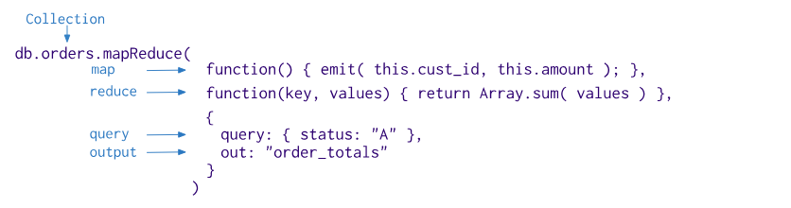
Map-Reduce Function
The Query, we perform here is of 3 parameters, 1st param is map function, 2nd param is reduce function, 3rd param is object (having two key value pairs.). Total funciton is doing 4 process on single query.

Slide 5
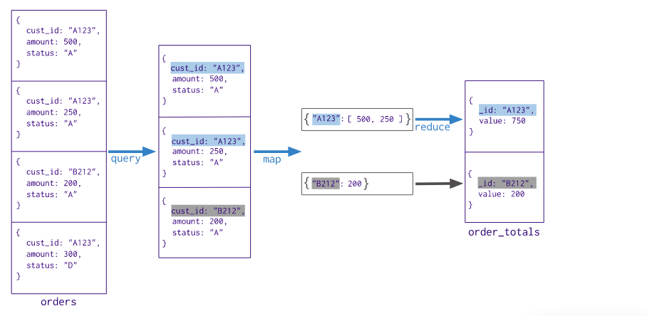
Result Map-Reduce Function

Slide 6
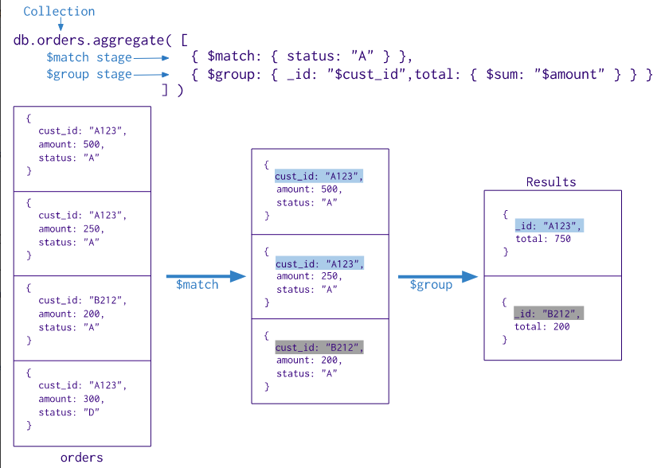
Aggregation Chain Mechanism

Slide 7
Aggregations Queries (Not Understand By Name)
$project - The $project takes a document that can specify the inclusion of fields, the suppression of the _id field, the addition of new fields, and the resetting of the values of existing fields. Alternatively, you may specify the exclusion of fields.
{ $project: { item:1, element:0 } }
$unwind - Open up the Array data into multiple documents from one documents.
db.inventory.aggregate( [ { $unwind : "$sizes" } ] )
$redact - Reshapes each document in the stream by restricting the content for each document based on information stored in the documents themselves

Slide 8
$project : Helps to joining tables with helps of ObjectId reference.
$geoNear: Helps to fetch data on case of location in aggregation.
$sample: Randomly selects the specified number of documents from its input.
$out: The $out operation creates a new collection in the current database if one does not already exist. The collection is not visible until the aggregation completes. If the aggregation fails, MongoDB does not create the collection.

Slide 9
Aggregation Pipeline Optimization
$sort + $match Sequence Optimization
$skip + $limit Sequence Optimization
The $match moves before the $sort to minimize the number of objects to sort.
{ $sort: { age : -1 } }, { $match: { status: 'A' } }
{ $match: { status: 'A' } }
{ $sort: { age : -1 } }
The $limit moves before the $skip. With the reordering, the $limit value increases by the $skip amount.
{ $skip: 10 }, { $limit: 5 }
{ $limit: 15 }, { $skip: 10 }

Slide 10
$project + $skip or $limit Sequence Optimization
{ $sort: { age : -1 } }, { $project: { status: 1, name: 1 } }, { $limit: 5 }
When you have a sequence with $project followed by either $skip or $limit, the $skip or $limit moves before $project.
{ $sort: { age : -1 } }, { $limit: 5 } { $project: { status: 1, name: 1 } },

Slide 11
$limit + $limit Coalescence
$skip + $skip Coalescence
When a $limit immediately follows another $limit, the two stages can coalesce into a single $limit where the limit amount is the smaller of the two initial limit amounts.
{ $limit: 100 }, { $limit: 10 }
{ $limit: 10 }
The two stages can coalesce into a single $skip where the skip amount is the sum of the two initial skip amounts.
{ $skip: 5 }, { $skip: 2 }
{ $skip: 7 }

Slide 12
$limit + $limit Coalescence
$skip + $skip Coalescence
When a $limit immediately follows another $limit, the two stages can coalesce into a single $limit where the limit amount is the smaller of the two initial limit amounts.
{ $limit: 100 }, { $limit: 10 }
{ $limit: 10 }
The two stages can coalesce into a single $skip where the skip amount is the sum of the two initial skip amounts.
{ $skip: 5 }, { $skip: 2 }
{ $skip: 7 }

Slide 13
$lookup + $unwind Coalescence ($unwing, by default preserveNullAndEmptyArrays is true (show all the Nuall or Empty things))
{ $lookup: { from: "otherCollection", as: "resultingArray", localField: "x", foreignField: "y" }}, { $unwind: "$resultingArray"}
{
$lookup: { from: "otherCollection", as: "resultingArray", localField: "x", foreignField: "y", unwinding: {
preserveNullAndEmptyArrays: false
} }
}
The $unwind operates on the as field of the $lookup, the optimizer can coalesce the $unwind into the $lookup stage. This avoids creating large intermediate documents.

Slide 14
Any Questions ?

Slide 15
Questions -
Add 50 User and 100 Address Collection, One User has multiple Address.
User properties - name, age, companyName, type, fatherName, motherName, Address ArrayIds as references.
Address Properties - houseNo, landmark, city, state, pincode.
Write a query for to fetch all address data from address in users. Limit should be 10 and skiping first five.

Slide 16
2. Fetch & Sort User data on base of user names, Sort Address cities in User table. Limit should be 5 and skipping first 5.
3. Fetch only address selective data (UserID:””, AddressData:”” ) from user table, keys should be like above.
4. Create indexes in Address table, on city and state. And Sort it.

Slide 17
Thank you
~ Hardeep Singh

